Slide 1
Title/chapter slide, title 1
Title 2
Author, DD.MM.YY

Slide 2

Title/chapter slide with image
Title 2
Author, DD.MM.YY

Slide 3
Grid, shoulder height.
Contents 1-column.
The red line indicates the shoulder height.
This marks the upper limit for scrolling text, images and graphics.
Exception: full-page images.
Images and text snap to grid.

Slide 4
Grid, shoulder height.
Contents 2 columns, narrow.
The red line indicates the shoulder height.
This marks the upper limit for scrolling text, images and graphics.
Exception: full-page images.
Images and text snap to grid.
The red line indicates the shoulder height.
This marks the upper limit for scrolling text, images and graphics.
Exception: full-page images.
Images and text snap to grid.

Slide 5
Grid, shoulder height.
Contents 3 columns.
The red line indicates the shoulder height.
This marks the upper limit for scrolling text, images and graphics.
Exception: full-page images.
Images and text snap to grid.
The red line indicates the shoulder height.
This marks the upper limit for scrolling text, images and graphics.
Exception: full-page images.
Images and text snap to grid.
The red line indicates the shoulder height.
This marks the upper limit for scrolling text, images and graphics.
Exception: full-page images.
Images and text snap to grid.

Slide 6
Grid, shoulder height.
Contents 2 columns, full width.
The red line indicates the shoulder height.
This marks the upper limit for scrolling text,
images and graphics.
Exception: full-page images.
Images and text snap to grid.
The red line indicates the shoulder height.
This marks the upper limit for scrolling text,
images and graphics.
Exception: full-page images.
Images and text snap to grid.

Slide 7
Page title, maximum 2 lines.
Contents 1-column.
Subtitle, optional
Scrolling text, Arial 18 pt, line spacing 22 pt. Markup.
  list
  list
  list

Slide 8
Page title, maximum 2 lines.
Contents 2 columns, narrow.
Subtitle, optional
Scrolling text, Arial 18 pt,
line spacing 22 pt.
Markup.
  list
  list
  list
Subtitle, optional
Scrolling text, Arial 18 pt,
line spacing 22 pt.
Markup.
  list
  list
  list

Slide 9
Page title, maximum 2 lines.
Contents 3 columns.
Subtitle, optional
Scrolling text, Arial 18 pt,
line spacing 22 pt.
Markup.
  list
  list
  list
Subtitle, optional
Scrolling text, Arial 18 pt,
line spacing 22 pt.
Markup.
  list
  list
  list
Subtitle, optional
Scrolling text, Arial 18 pt,
line spacing 22 pt.
Markup.
  list
  list
  list

Slide 10
Page title, maximum 2 lines.
Contents 2 columns, full width
Subtitle, optional
Scrolling text, Arial 18 pt, line spacing 22 pt.
Markup.
  list
  list
  list
Subtitle, optional
Scrolling text, Arial 18 pt, line spacing 22 pt.
Markup.
  list
  list
  list

Slide 11
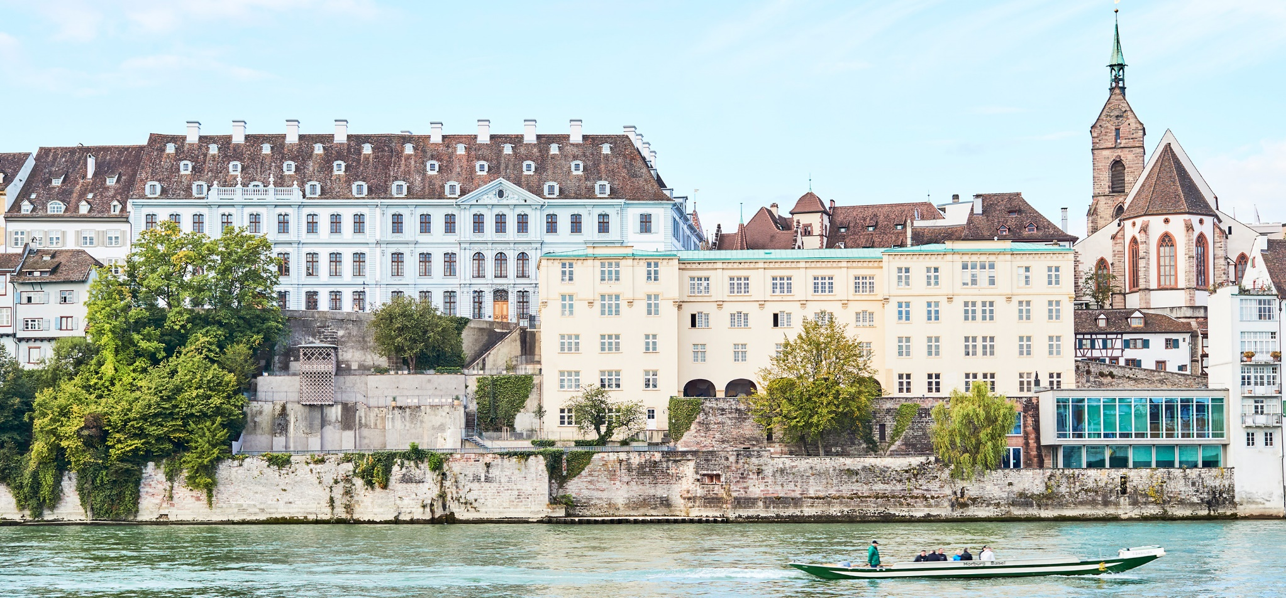
Using images, example 1.
Image caption title.
Image caption.

Slide 12
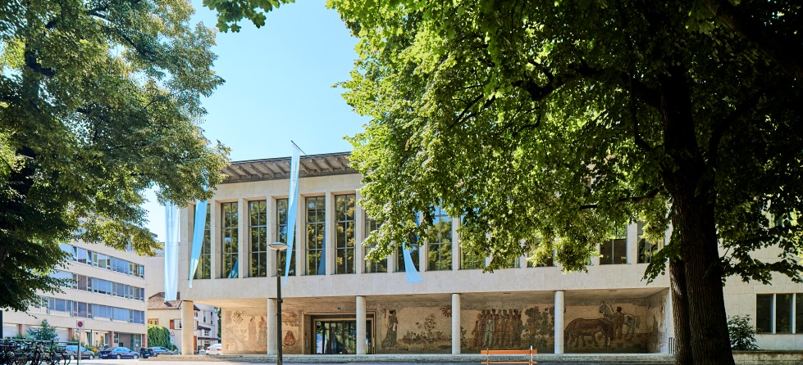

Using images, example 2.
Image caption title. Image caption.
Image caption title. Image caption.

Slide 13
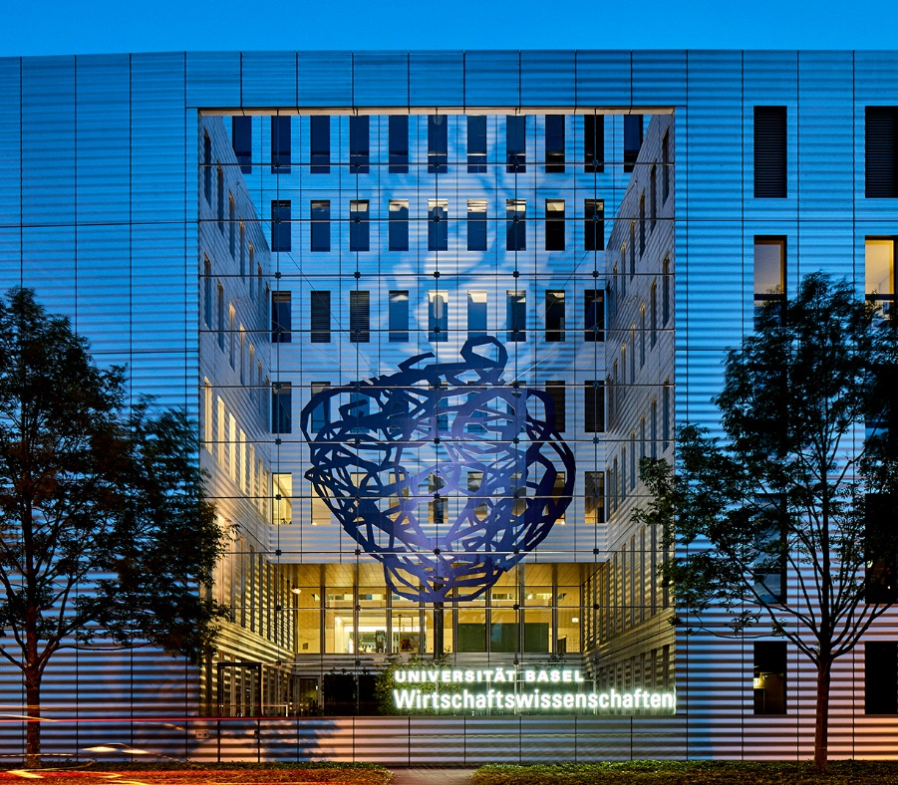


Using images, example 3.
Image caption title. Image caption.
Image caption title. Image caption.
Image caption title. Image caption.

Slide 14

Image caption title. Image caption.

Slide 15


Slide 16
Colours.
R 165
G 215
B 210
R 30
G 165
B 165
R 45
G 55
B 60
R 140
G 145
B 150
R 210
G 5
B 55
R 235
G 130
B 155
R 190
G 195
B 200
R 0
G 110
B 110
R 0
G 0
B 0
R 255
G 255
B 255
1
2
3
4
5
6
7
8
9
10
The sequence for the ten colors is defined.
The first color used is mint.

Slide 17
Agenda.
1 | Situation – where we stand
2 | Goals – what we want to achieve
3 | Strategy – how we execute
4 | Action – what we implement
5 | Next steps – what needs to be decided

Slide 18
Agenda.
1 | Situation – where we stand
2 | Aims – what we want to achieve
3 | Strategy – how we execute
4 | Action – what we implement
5 | Next steps – what needs to be decided

Slide 19
Bar chart, example 1.
Chart texts are concise, clear and relates to the diagram shown only.

Slide 20
Bar chart, example 2.
Chart texts are concise, clear and relates to the diagram shown only.

Slide 21
Bar chart, example 3.
Chart texts are concise, clear and relates to the diagram shown only.

Slide 22
Bar chart, example 4.

Slide 23
Histogram.
Histograms are concise, clear and relates to the diagram shown only.

Slide 24
Pie chart.
Pie charts are concise, clear and relates to the diagram shown only.

Slide 25
Line chart.
Line charts are concise, clear and relates to the diagram shown only.

Slide 26
Table, example.
Title, Arial bold, 16pt. | 2015 | 2014 | 2013
Text Arial 16 pt | 100 | 21 | 328
Text Arial 16 pt | 938 | 2 | 23
Text Arial 16 pt | 3940 | 321 | 291
Text Arial 16 pt | 100 | 21 | 328
Text Arial 16 pt | 938 | 2 | 23
Text Arial 16 pt | 3940 | 321 | 291
Text Arial 16 pt | 938 | 2 | 23
Text Arial 16 pt | 3940 | 321 | 291

Slide 27
Thank you for your attention.

